Slide 1
INTRODUCTION TO MYSELF

Slide 2
I am Mahipal Malaviya.
I am living Rajasthan District Pali.
I am very punctual and like to do my all works throughout the day at right time.
I love to eat simple and healthy food.
I like reading books, playing Cricket and in my spare time.

Slide 3
I AM….
HONEST..
DISCIPLINED..
RESPECTFUL..
STRONG..
IMPATIENT..
I am very punctual and like to do my all works throughout the day at right time.

Slide 4
S.W.O.T ANALYSIS
STRENGTH : WEAKNESS :
Communication skills Overthinking
Hardworking Public speaking
Leadership
Team work

Slide 5
S.W.O.T ANALYSIS
OPPURTUNITIES : THREATS :
To work with different clients. High Competition.
Create a team work on an idea. More Advancement in AI
To learn from great minds.
Get help on projects.

Slide 6

I LOVE….
MY FAMILY
TRAVELLING
MY SELF
SPEND TIME WITH FRIENDS
READING BOOKS
PLAYING GAMES

Slide 7

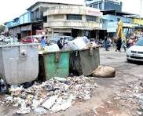
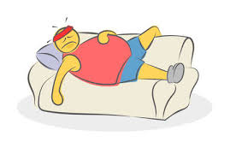
I HATE….
Laziness
Don’t waste food
Cheating
Dirty Place
Anger

Slide 8
If you believe in yourself anything is possible.

Slide 9
THANK YOU

